Slide 1
IB MATH:
Explaining the IA criteria
A presentation for students

Slide 2
What is the Exploration?
Pick an area of interest and write a 12-20 (ish) double spaced paper exploring the math related to it.
Use math from the IB syllabus…
…Or learn new math that is at same level.

Slide 3
What do I need to do?
The format:
  Briefly introduce the topic
  state the aim
  do some math
  reflect on it
  repeat as needed
  conclude
  add personal engagement along the way
  Properly cite all your sources

Slide 4
What do I need to submit?
There are three different submissions during the process, with teacher feedback at each stage
  1) Topic proposal
  2) Draft exploration
  3) Final version

Slide 5
The Criteria
A: Presentation 4 marks
B: Mathematical Communication 4 marks
C: Personal Engagement 3 marks
D: Reflection 3 marks
E: Use of Mathematics 6 marks

Slide 6
A: Presentation
Must have an explicit and detailed aim
Bad: To explore the math behind Covid-19
Good: To determine a model to predict the number of cases of Covid-19 in Canada if social distancing had not been in place

Slide 7
A: Presentation
The “woah” factor
  Coherence
    - Logically developed, easy to follow, meets the aim
  Conciseness
    - No unnecessary information; everything relates back to aim (max 12ish pages)
Repetitive calculations are not condoned.

Slide 8
A: Presentation
Well organized:
- logical order
- relevant graphs/tables/charts in the appropriate place
- appendices used for large data sets, additional graphs/tables/charts, survey questions

Slide 9
A: Presentation
Proper citations:
- graphs/tables where they appear
- direct quotes when needed
- bibliography at the end; more than just a list of websites
- Refer to the IB Citation Guide

Slide 10
A: Presentation Con’t
The rubric wording:
0 – nothing
1 – SOME coherence OR SOME organization
2 – SOME coherence AND SOME organization
3 – coherent AND well organized
4 – coherent, well organized, and concise

Slide 11
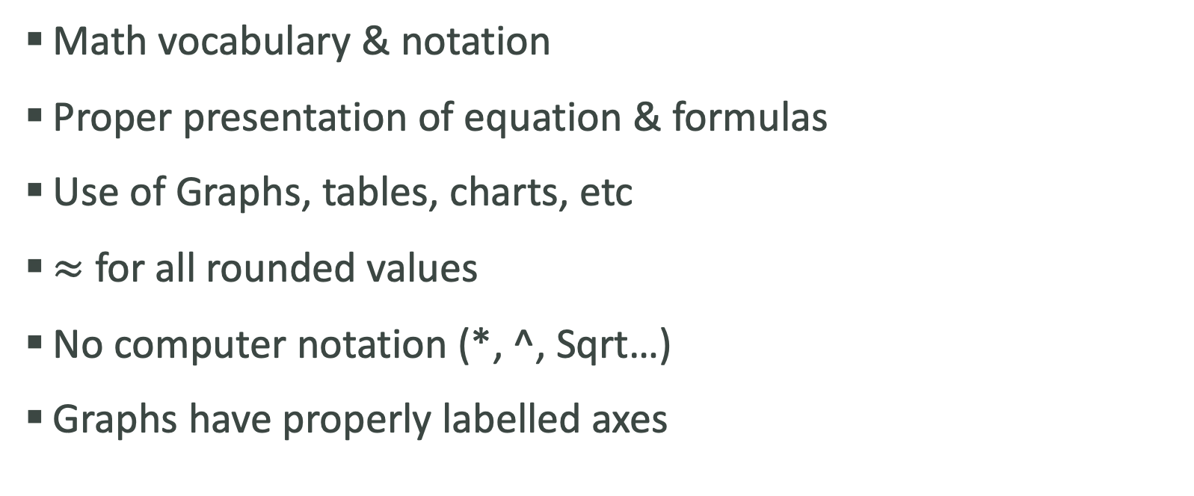
B: Mathematical Communication
Math vocabulary & notation
Proper presentation of equation & formulas
Use of Graphs, tables, charts, etc
$≈$ for all rounded values
No computer notation (*, ^, Sqrt…)
Graphs have properly labelled axes

Slide 12
B: Mathematical Communication Con’t
Justification of the chosen degree of accuracy for rounded values in relation to the topic
  Ex:
200 mph?
200.1 mph?
200.01 mph?
5 mg?
0.5 mg?
0.005 mg?

Slide 13
B: Mathematical Communication Con’t
The rubric wording:
0 – nothing
1 – some, partially appropriate
2 – some, appropriate
3 – relevant, appropriate, mostly consistent
4 – relevant, appropriate, consistent

Slide 14
Lets play a game!
What might this graph be about?

Slide 15
Why we label axes of a graph Con’t!

Slide 16
Why we label axes of a graph Con’t!

Slide 17
Why we label axes of a graph Con’t!

Slide 18
Why we label axes of a graph Con’t!

Slide 19
Why we label axes of a graph Con’t!

Slide 20
C: Personal Engagement
Interest, not excitement!!!!!
Meant to drive the paper forward
Putting your voice into the IA
What makes your IA different than a textbook or website?
Must be evident in the exploration itself.
Not a mark for how hard you worked.

Slide 21
C: Personal Engagement
Some ways to add personal engagement:
- design your own survey
- collect your own data
- do an experiment
- create your own examples
- consider historical & global perspectives
- invent your own game
- apply your results to a different real-world application
- ask meaningful questions
- make conjectures and prove them
- learn new math
- State this in the paper
- Briefly discuss that journey; any difficulties you faced and how you overcame them

Slide 22
C: Personal Engagement
Note:
Finding data online is NOT personal engagement.
This is just research.

Slide 23

C: Personal Engagement Con’t

Slide 24
C: Personal Engagement Con’t
In the video, how did Vi show her personal engagement?
What did she say?
What kinds of rhetorical questions did she ask?

Slide 25
C: Personal Engagement Con’t
The rubric wording:
0 – nothing
1 – some
2 – significant
3 – outstanding

Slide 26
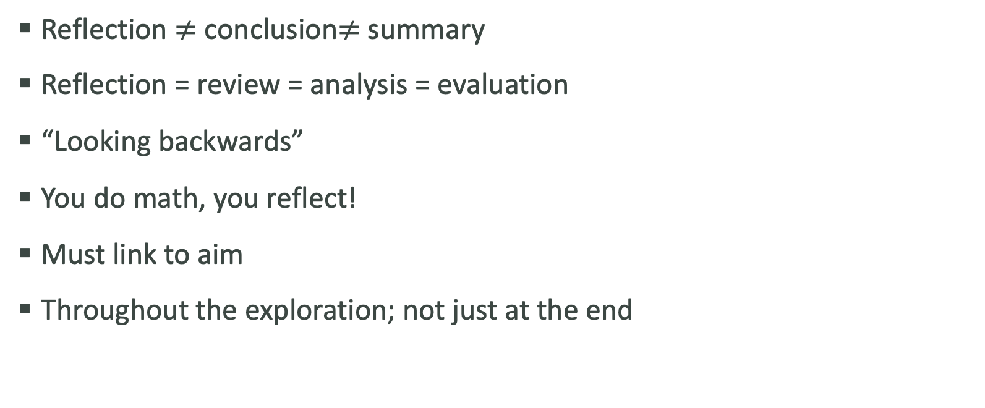
D: Reflection
Reflection $≠$ conclusion$≠$ summary
Reflection = review = analysis = evaluation
“Looking backwards”
You do math, you reflect!
Must link to aim
Throughout the exploration; not just at the end

Slide 27
D: Reflection Con’t
Some ways to add reflection:
- discuss your results in relation to your topic
- comment on what you learned
- talk about what you would do differently
- discuss limitations of your results
- discuss extensions of your results
- comparing different mathematical approaches
- discuss implication of your results
- discuss strengths & weaknesses of approaches
- consider different perspectives

Slide 28
D: Reflection Con’t
The rubric wording:
0 – nothing
1 – limited
2 – meaningful
3 – substantial & critical

Slide 29
E: Use of Mathematics
Note:
This is the only criteria that differs from SL to HL.
There is no distinction between AA and AI.

Slide 30
E: Use of Mathematics Con’t
More than just using correct math.
Knowledge & understanding must be shown.
The math used must relate to the aim.

Slide 31
E: Use of Mathematics SL
The rubric wording for SL:
0 – nothing
1 – relevant math/no understanding shown
2 – relevant math/limited understanding shown
3 – SL level math/limited understanding shown
4 – SL level math/some understanding shown/partially correct
5 – SL level math/good understanding shown/mostly correct
6 – SL level math/thorough understanding shown/correct

Slide 32
E: Use of Mathematics Con’t
For HL, must show rigour and sophistication
  Rigour: clarity of logic and language when making mathematical argument and calculations. Mathematical claims must be justified or proven
  Sophistication: HL topics or SL topics used beyond what is expected from an SL student

Slide 33
E: Use of Mathematics HL
The rubric wording for HL:
0 – nothing
1 – no HL math/limited understanding
2 – no HL math/some understanding/partially correct
3 – correct HL math/some understanding
4 – correct HL math/good understanding
5 – correct HL math/sophistication or rigour/thorough understanding
6 – correct precise HL math/sophistication and rigour/thorough understanding

Slide 34
Sources
IB DP Mathematics: Analysis and Approaches Guide, first assessment 2021
IB DP Mathematics: Analysis and Approaches Teacher Support Material, first assessment 2021
IB DP Mathematics: Applications and Interpretation Guide, first assessment 2021
IB DP Mathematics: Applications and Interpretation Teacher Support Material, first assessment 2021

